Slide 1
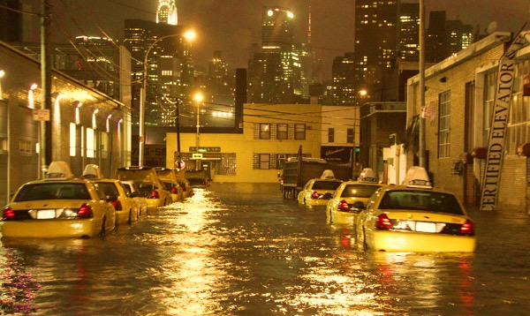
FLOODING NYC
by DEM-ocratic team
1ST CUSP HACKATHON
2017/2018

Slide 2
DEM-ocratic teams!
Andrew
Charlie
Jack
Lingyi
Nina

Slide 3
Deliverable
Model to predict true flooding
Data
311 Data
NYC Digital Elevation Model (DEM)

Slide 4
Data Wrangling
Filtered data by complaint Type “Standing Water” from 2013-present
Extracted the elevation of each 311 data from DEM
Counted the number of 311 calls per each census block
Aggregated the elevation per census block by mean, min, max value from 311 calls
Normalized the data by creating the propensity rate (total counts divided by the sum of top 5 complaint type calls) per census block

Slide 5
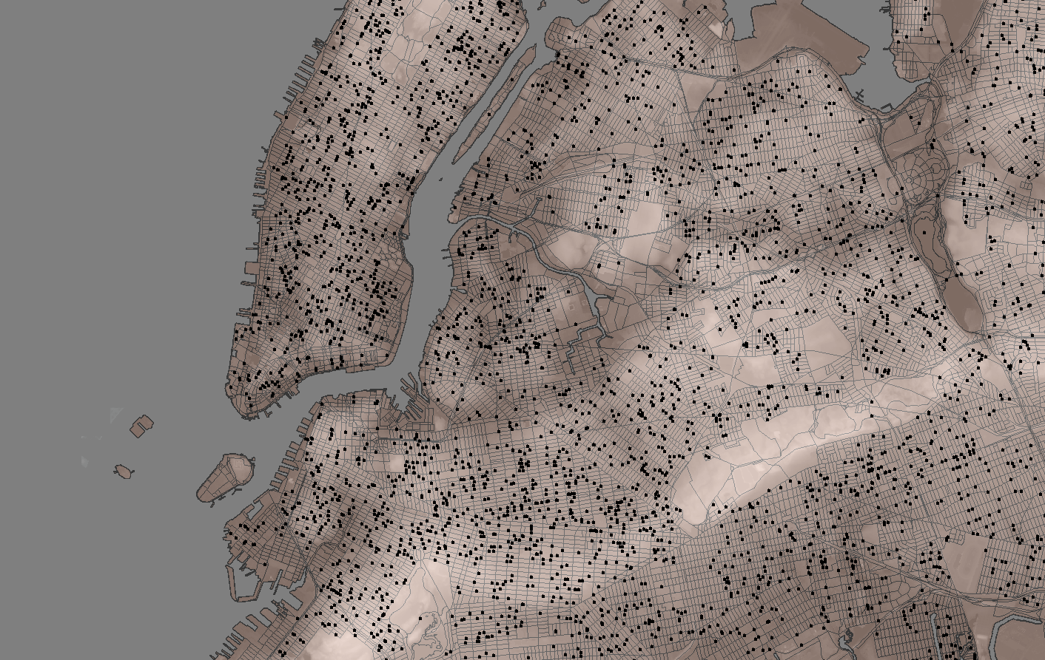
Figure 1. Map of 311 calls complaining about standing water and its elevation

Slide 6
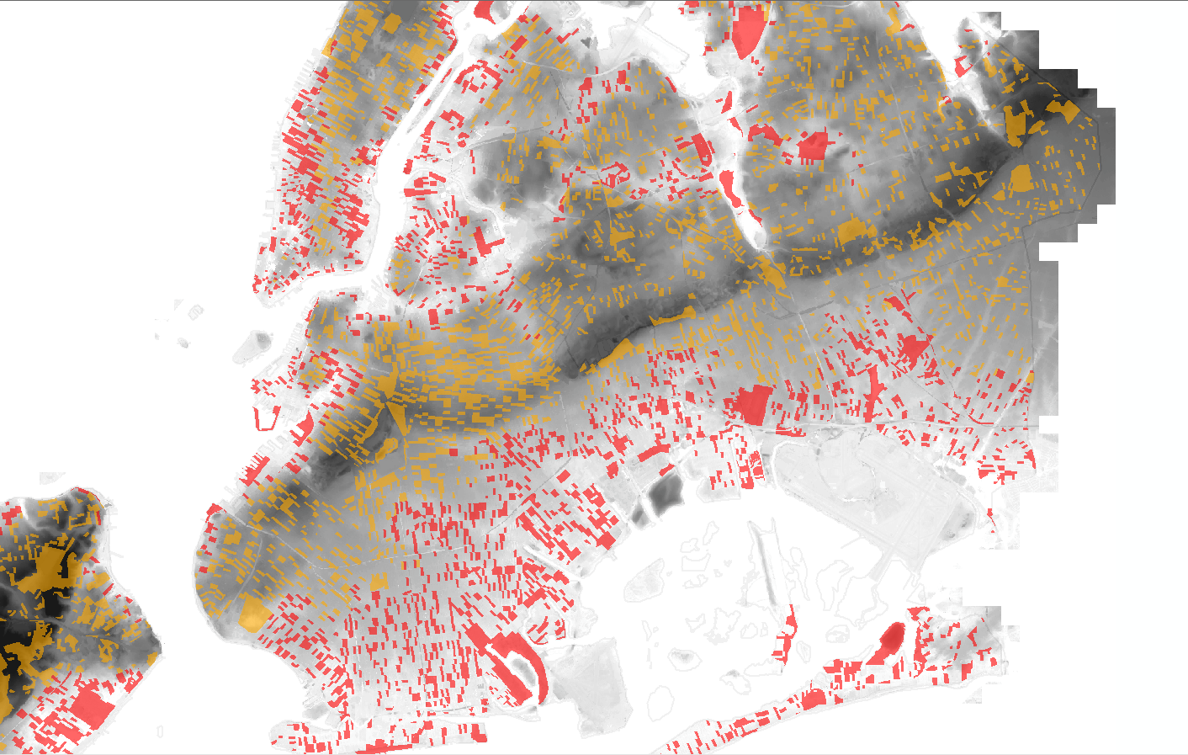
Figure 2. Average surface elevation by Census block with complaints

Slide 7
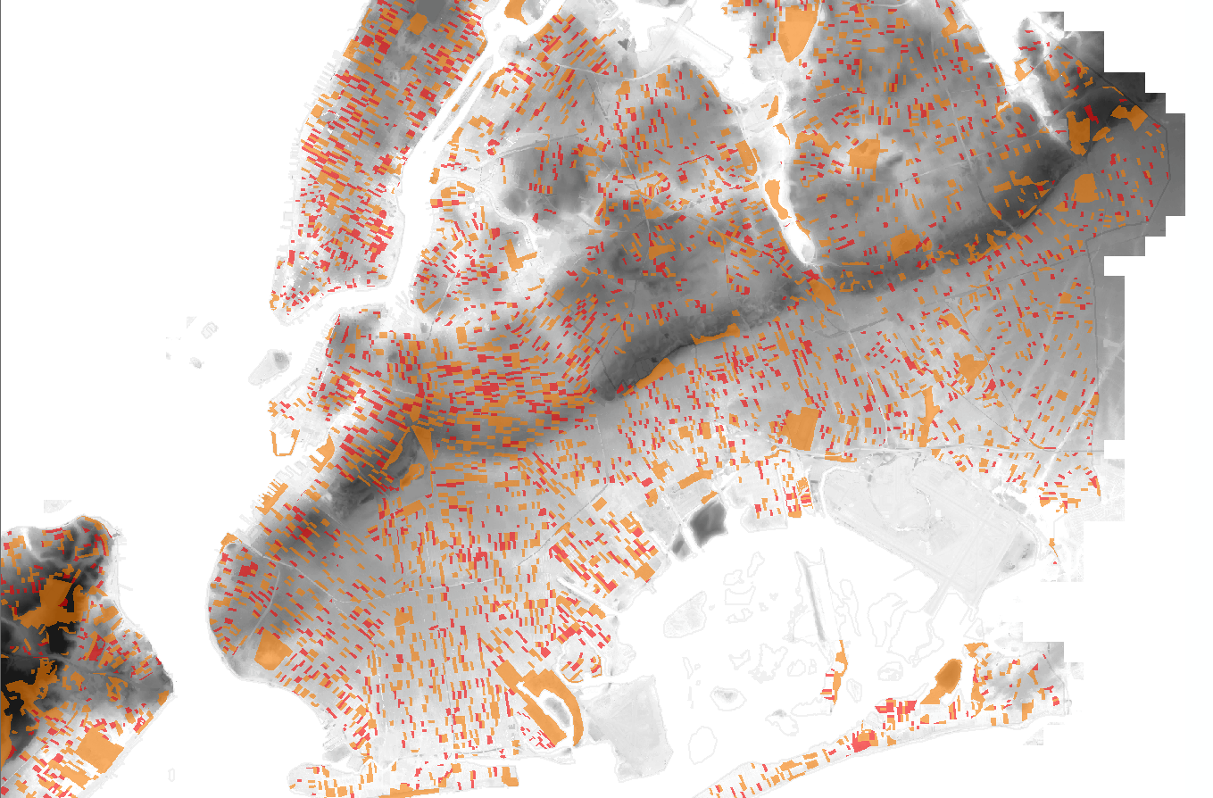
Figure 3. Map of complaint counts normalized by area

Slide 8
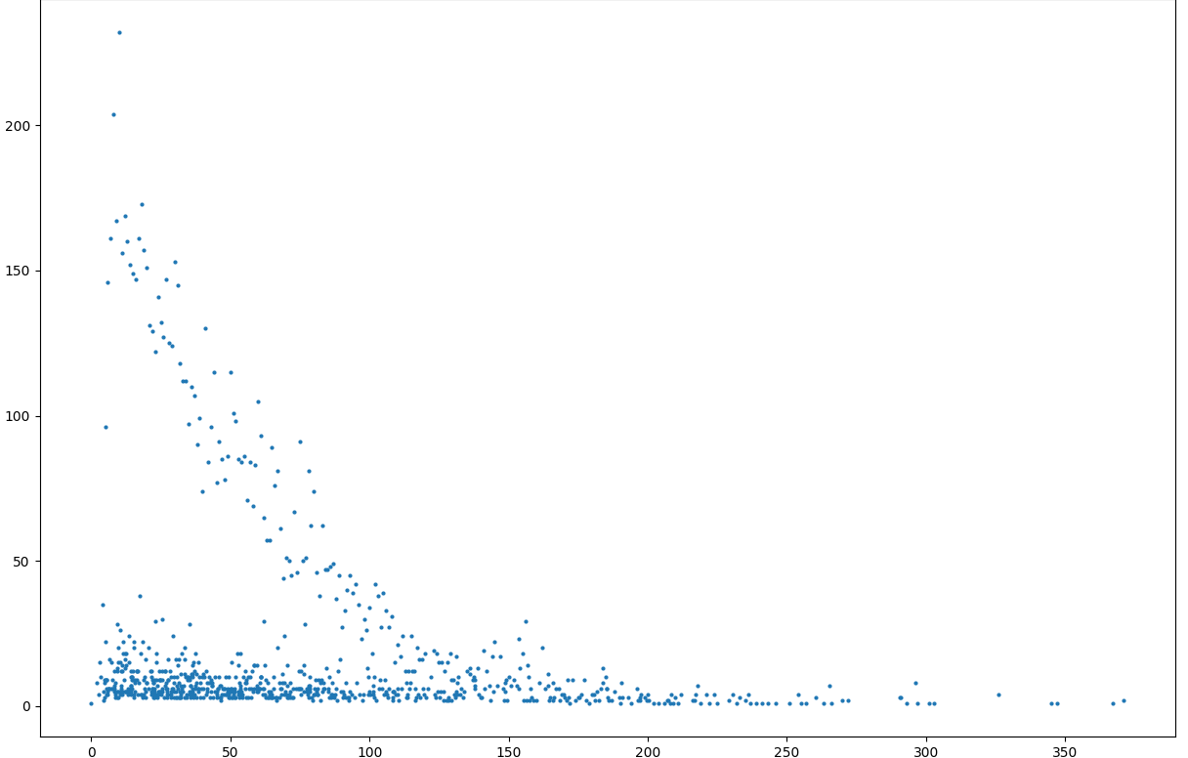
Figure 4. 311 complaints vs elevation
311 COMPLAINT NUMBER
ELEVATION

Slide 9
Data Modelling
Gaussian Mixture
K-Means

Slide 10
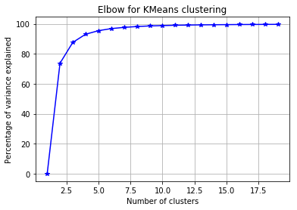
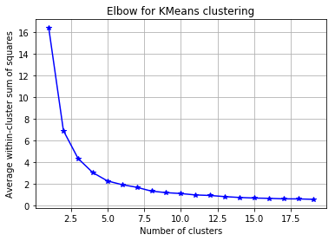
Figure 5. Elbow method suggests 4 clusters

Slide 11
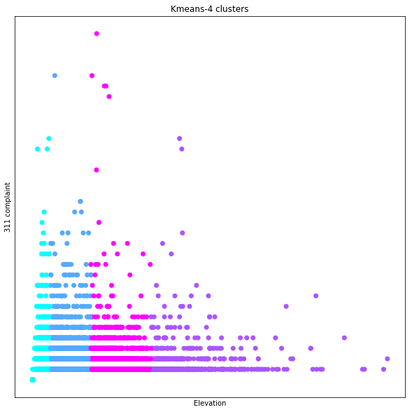
Figure 6. K-means 4 cluster
311 COMPLAINT NUMBER
ELEVATION

Slide 12
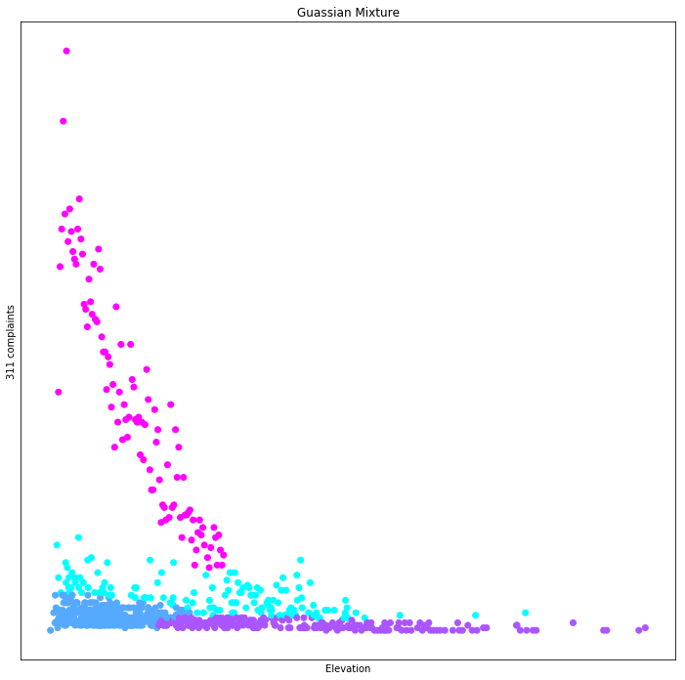
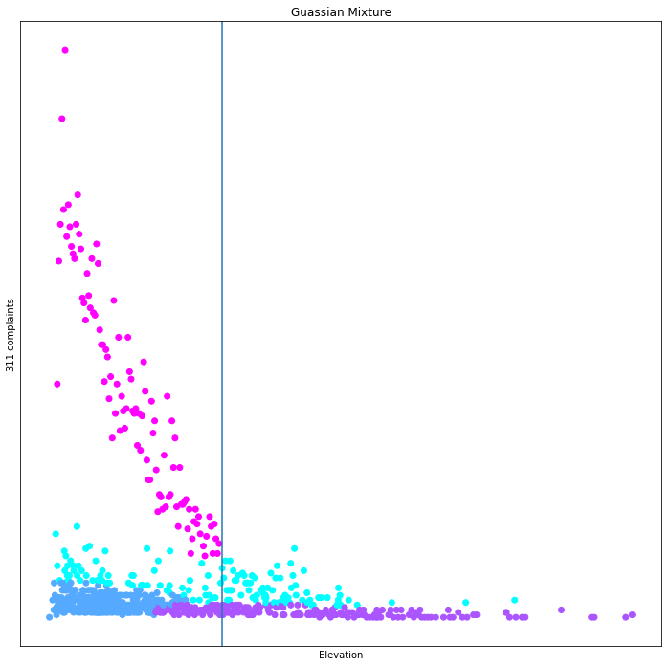
311 COMPLAINT NUMBER
ELEVATION
110
Figure 7. Gaussian Mixture

Slide 13
1-DAY LIMITATION!
The space area is based on census block (smaller than census tract), but it is still larger for aggregating the flood area and it has different area for each block.
Elevation from the census block is not the real mean, because it is derived from the elevation from the calls. (calculating the whole polygon is taking forever!)
For now, we only consider elevation not the slope.
We didn’t have time to consider the demographics or any other callers background characteristic.
We didn’t consider weather.

